Slide 1
Data Science Process Pipeline to solve employee Attrition and their Job Performance and Predicting With AI (Batch d19)
Vanka Hari Janardhan – 16N31A05P9
S Vinay – 16N31A05J6
T Manikanta Naga Hanuman – 16N31A05N0
PROJECT GUIDE – Mr. T Siva Ratna Sai

Slide 2
Contents
Abstract
Introduction
Existing System
Proposed System
Requirements
Modules
System Architecture
UML Diagrams
Code Execution with Outputs
Conclusion

Slide 3
ABSTRACT
Employee attrition is one of the key problems in today’s scenario. Attrition is said to be gradual reduction in number of employees through resignation, death and retirement.
When an employee leaves the organization for any reason, it creates an empty space in an organization. It creates a great difficulty for a Human resource personnel to fill the gap that has occurred.
Many of the employees may also tend to leave the job for various undisclosed factors. This study helps in predicting employee attrition.

Slide 4
Introduction
Machine learning is the study of computer algorithms that improve automatically through experience. It is seen as a subset of artificial intelligence.
They build a mathematical model based on sample data, known as training data, in order to make predictions or decisions without being explicitly programmed to do so.
They are used in a wide variety of applications, such as email filtering and computer vision, where it is difficult or infeasible to develop conventional algorithms to perform the needed tasks.
It is closely related to computational statistics, which focuses on making predictions using computers. In its application across business problems, machine learning is also referred to as predictive analytics.

Slide 5
EXISTING SYSTEM
It is hard to find out the reasons that why employees are leaving an organization and keeping them satisfied is a big challenge, for this a report is made to predict the retention of an employee in an organization using python with data science methods and machine learning.
Earlier the results showed were on basis of information-sharing and information-seeking behaviours and general usage behaviours during working hours.
Drawback of this system was it was time consuming as well as performance wise it is low, to increase the efficiency we moved to proposed methodology.

Slide 6
PROPOSED SYSTEM
This project provides solution for the given problem as it gives a prediction model that can be used to predict which employee will leave the company and which will not leave.
It also helps in finding the exact reasons which are motivating the employees for shifting companies. To find the result in the form of yes or no.
We use algorithms such as Support Vector Machines, Random Forest Classifier, Multi-Layer Perceptron Classifier as well as Logistic Regression.

Slide 7
Requirements
Hardware: RAM – 4GB
Software: OS – Windows 7, 8 and 10 (32 and 64 bit) Python IDLE with required built-in modules Anaconda Navigator

Slide 8
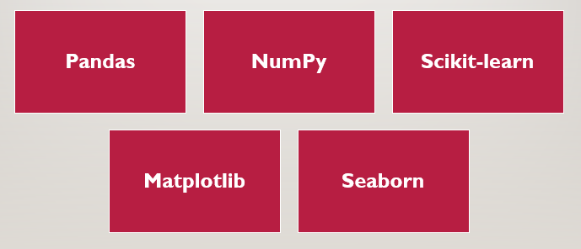
MODULES

Slide 9
NumPy
NumPy is a library for the Python programming language, adding support for large, multi-dimensional arrays and matrices, along with a large collection of high-level mathematical functions to operate on these arrays. Using NumPy in Python gives functionality comparable to MATLAB since they are both interpreted, and they both allow the user to write fast programs as long as most operations work on arrays or matrices instead of scalars.
Pandas
It is a software library written for the python language for data manipulation and analysis. In particular, it offers data structures and operations for manipulating numerical tables and time series. The name is derived from the term "panel data", an econometrics term for data sets that include observations over multiple time periods for the same individuals.

Slide 10
Scikit-learn
Scikit-learn is a free software machine learning library for the Python programming language. It features various classification, regression and clustering algorithms including support vector machines, random forests, gradient boosting, k-means and DBSCAN, and is designed to interoperate with the Python numerical and scientific libraries NumPy and Pandas.
Matplotlib
Matplotlib is a plotting library for the Python programming language and its numerical mathematics extension NumPy. It provides an object-oriented API for embedding plots into applications using general-purpose GUI toolkits like Tkinter, wxPython, Qt, or GTK+.
Seaborn
It is a Python data visualization library based on matplotlib. It provides a high-level interface for drawing attractive and informative statistical graphics. Seaborn aims to make visualization a central part of exploring and understanding data.

Slide 11
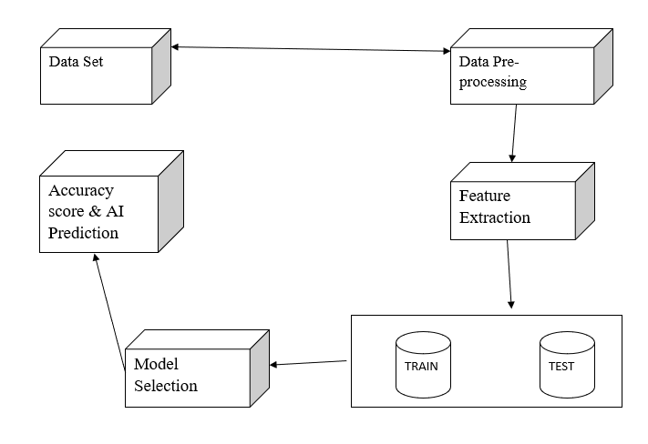
System Architecture

Slide 12
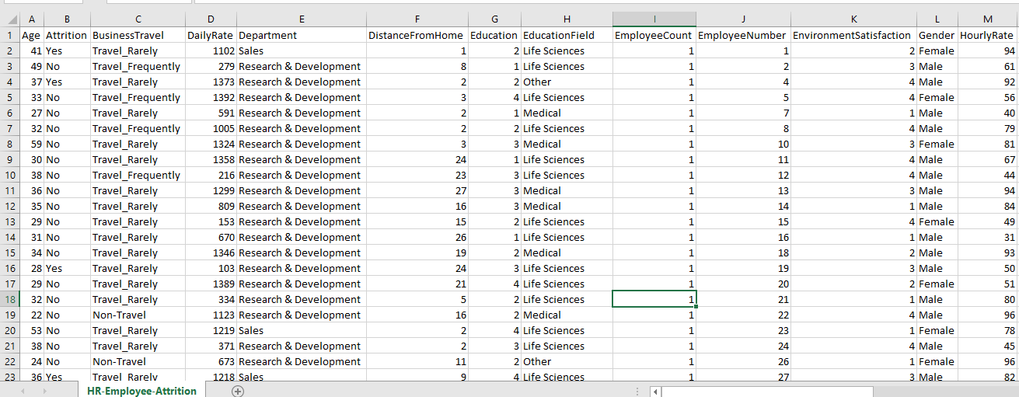

Slide 13
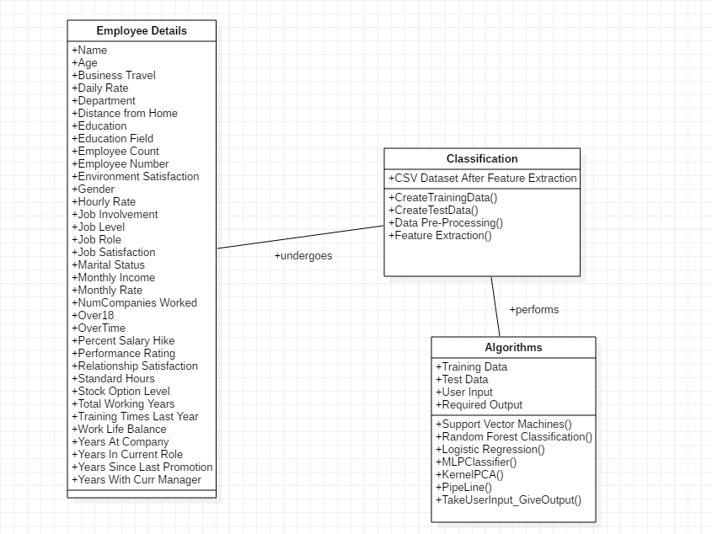
CLASS DIAGRAM

Slide 14
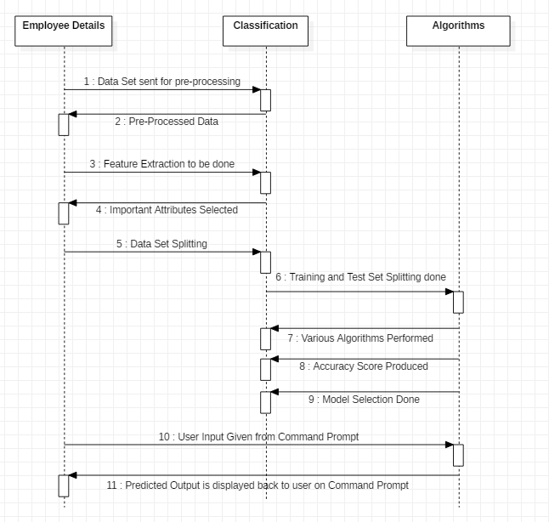
SEQUENCE DIAGRAM

Slide 15
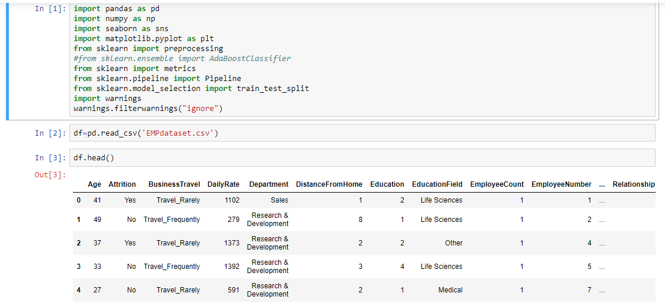

Slide 16
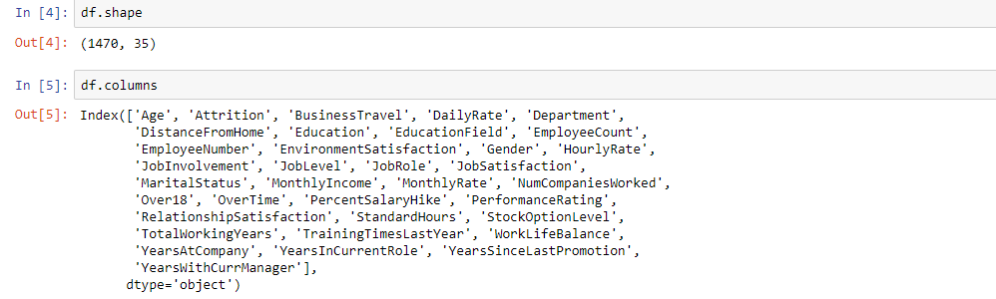

Slide 17
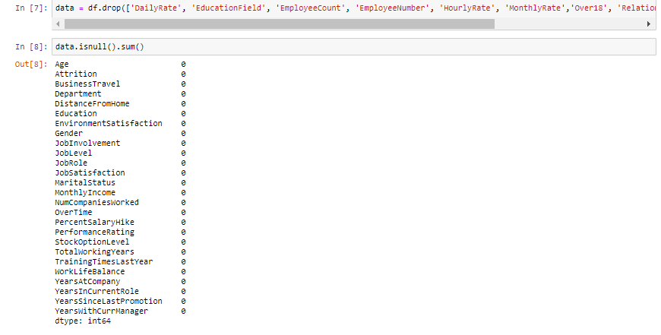

Slide 18
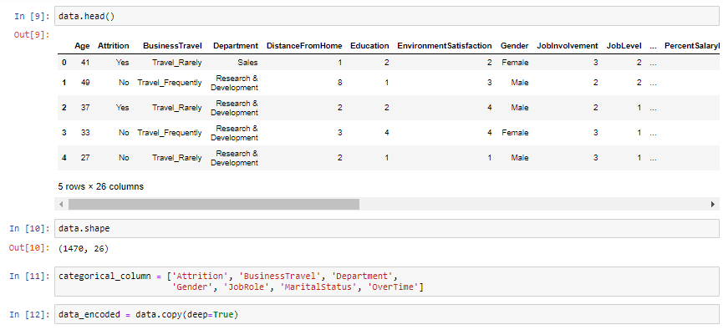

Slide 19
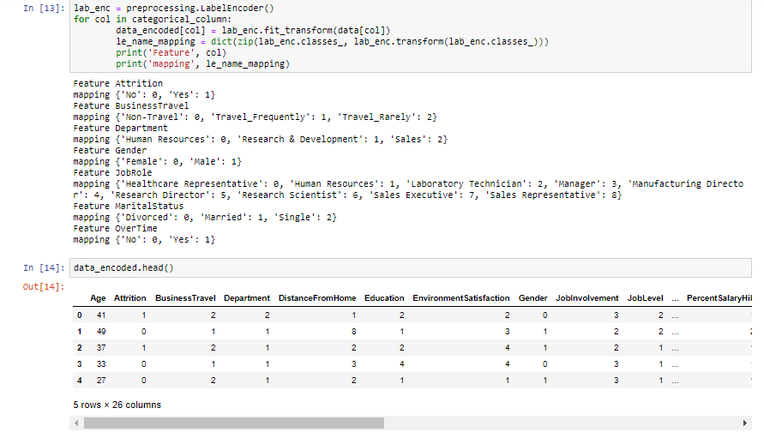

Slide 20
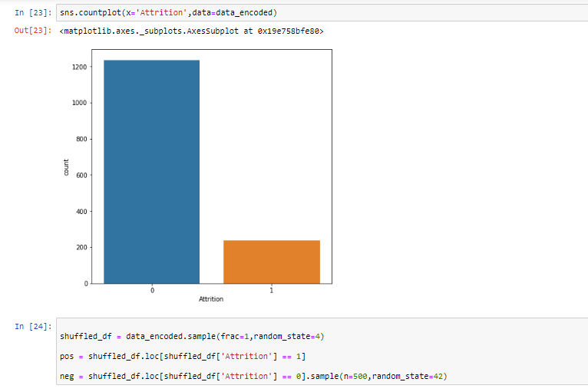

Slide 21
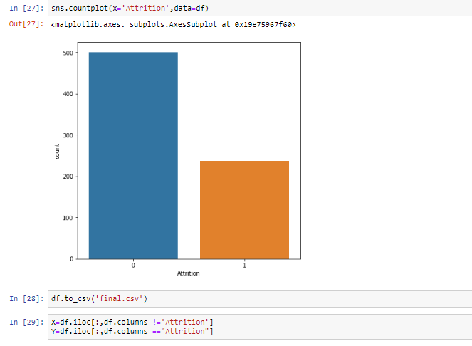

Slide 22
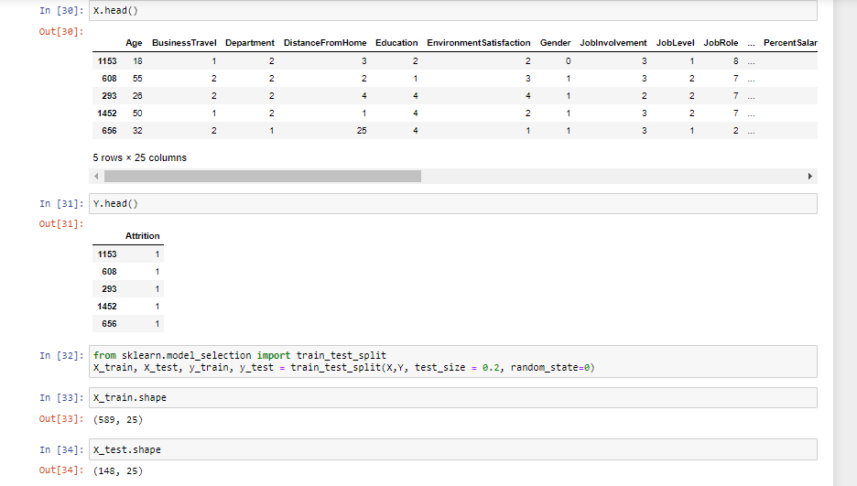

Slide 23
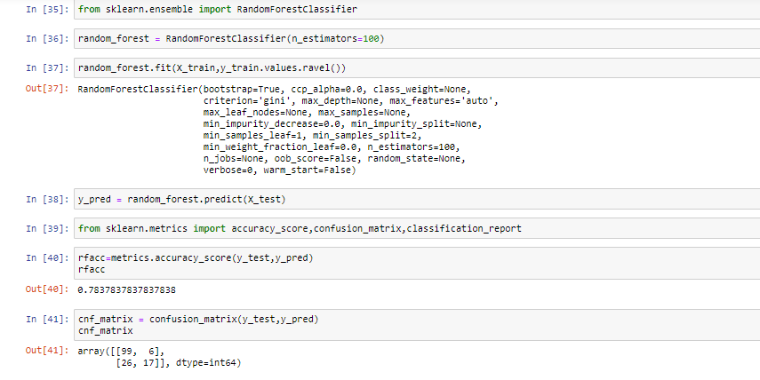

Slide 24
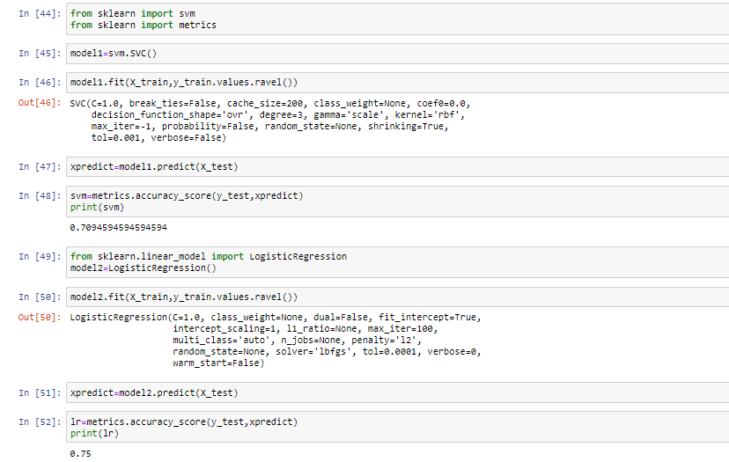

Slide 25
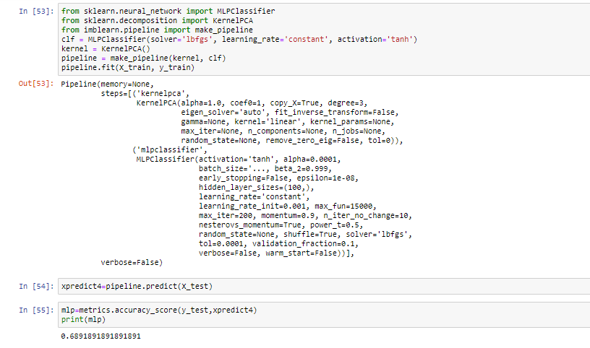

Slide 26
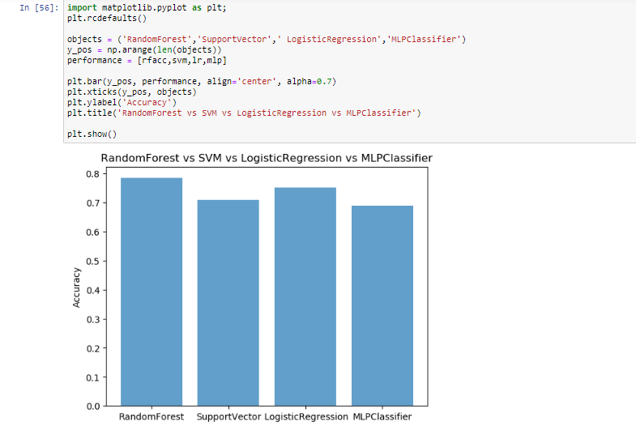

Slide 27
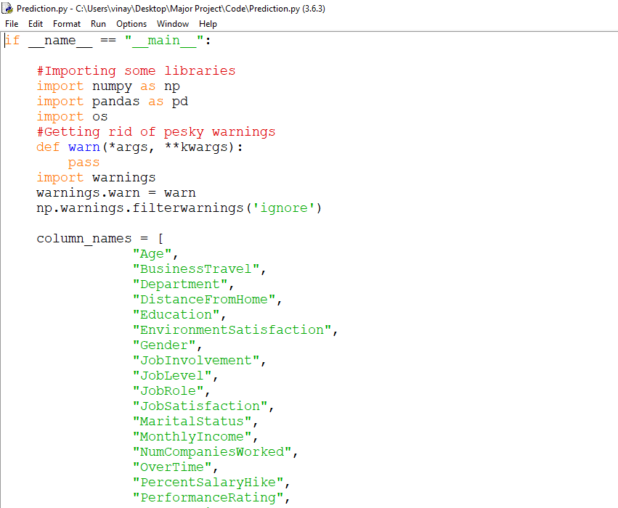

Slide 28
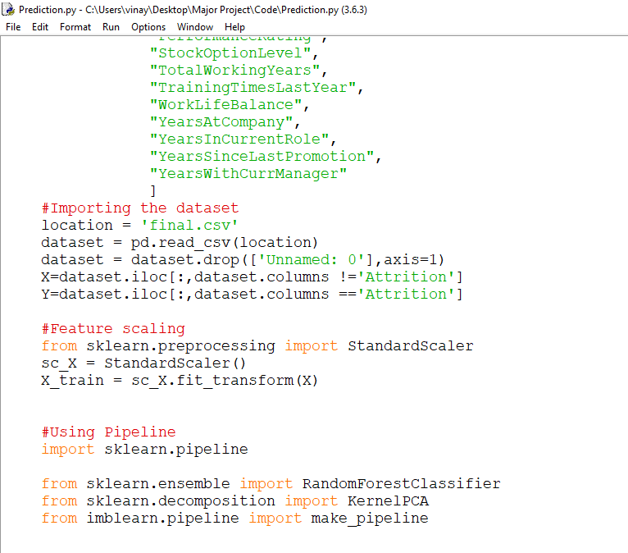

Slide 29
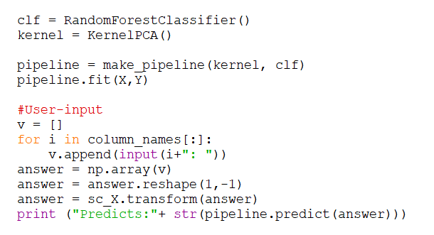

Slide 30
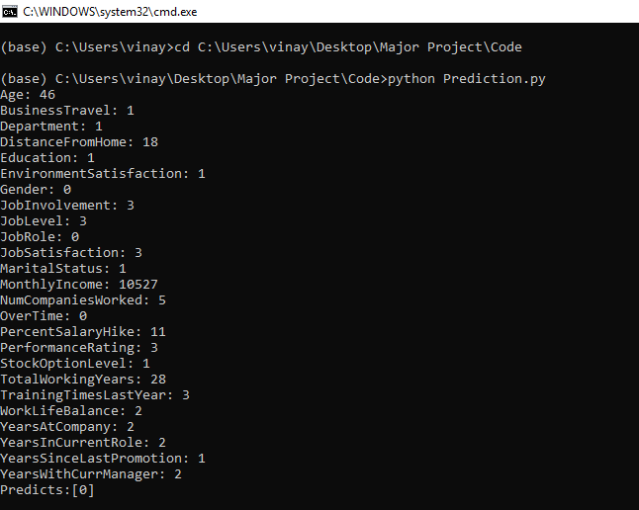

Slide 31
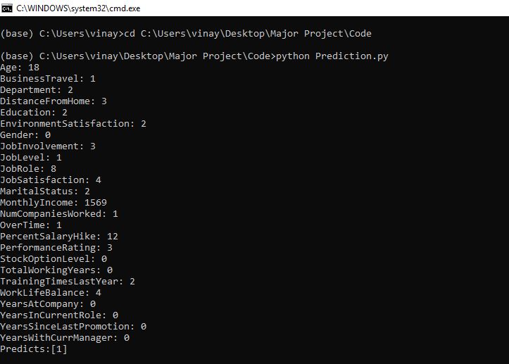

Slide 32
conclusion
The main objective of the organization is to earn profit and to do that the employer should concentrate in retaining talents and making them stick to the organization for the long run.
Employees are the assets of the organization. Hence it is important for the employers to minimize the attrition rate and help in both individual as well as organizational growth.
It can be concluded that the major reasons for employee turnover are opportunity for growth and promotion outside, compensation, working conditions, work timings/shifts, relationship with managers, location of the organisation and workload.

Slide 33


